Slide 1

Hotel Booking Demands

Slide 2

Agenda
About our dataset
Dataset Characteristics
Analysis questions
Summary

Slide 3

About our dataset

Slide 4
About our dataset
This data set contains booking information for a city hotel and a resort hotel.
It includes information such as when the booking was made, length of stay, the number of adults, children, and/or babies, and the number of available parking spaces, among other things.
The data is originally from the article Hotel Booking Demand Datasets.
It consists of 119390 rows and 32 columns.

Slide 5

Dataset characteristics

Slide 6
Dataset characteristics
Our dataset contains:
Missing values: resides in columns ‘country’ , ‘agent’ and ‘company’.
Categorical data: in multiple columns such as reservation_status and customer_type
Outliers: multiple columns contains outliers such as ‘adr’ and ‘total_of_special_requests’
Imbalanced: our target column ‘is_canceled’ is imbalanced.
Aim of the project:
The target is to predict whether the client will cancel his reservation or not.

Slide 7

Analysis Questions

Slide 8
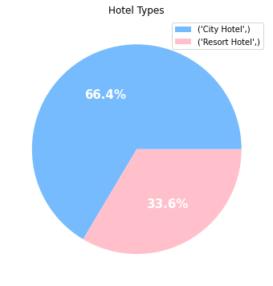
Hotel types
We have two types of hotels:
City Hotel
Resort Hotel
Hotel | percentage
City Hotel | 66.446101
Resort Hotel | 33.553899

Slide 9
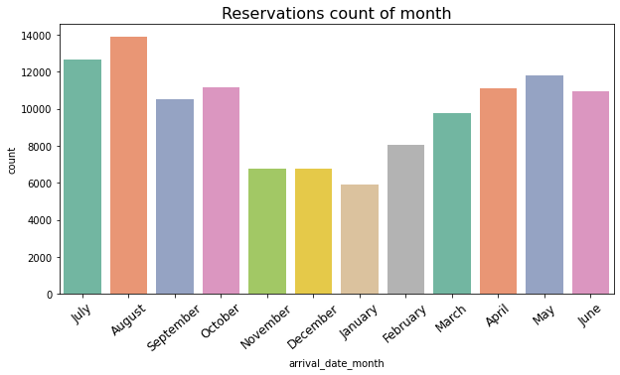
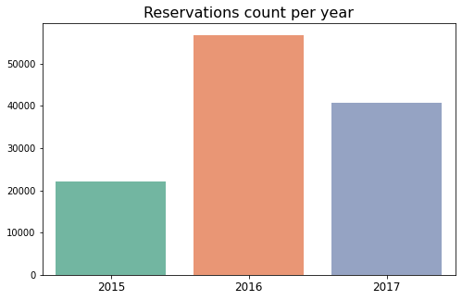
Reservations
Which year had the largest number of reservations?
2016 had the largest number of reservation of 47.5% and 2015 had the lowest number of reservations of 18.42%
Which month have the most reservations?
August had the largest number of reservations of 11.6% and January had the lowest number of reservations of 4.9%

Slide 10
Reservations cont.
Which room type have been reserved the most?
Room type ‘A’ had been reserved the most with 72.02% While room type ‘L’ had the least number of reservations of 0.05%
What is the average number of adults per?
The average number of adults per reservation is reservation2.
what is the average number of children/babies per reservation?
The average number for both babies and children is 1.
What is the average number of waiting list days?
2 is the average number of waiting list days per reservation.

Slide 11
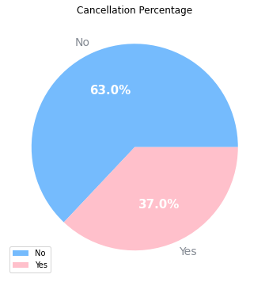
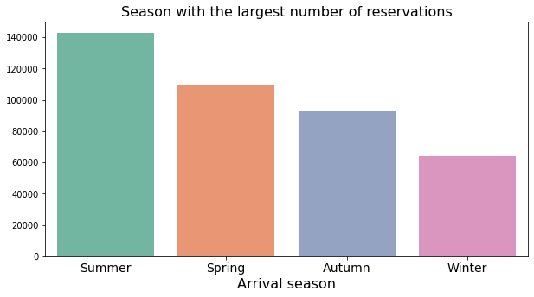
Reservations cont.
Which season had the largest number of reservations?
Summer had the largest number of reservation of 34.9% and winter had the lowest number of reservations of 15.61%
How many reservations have been cancelled?
About 37.0% of our customers cancelled their reservation.

Slide 12



Loyal Customers
How many loyal customers do we have?
We don’t have a lot of loyal customer as their percentage is only 3.2% of the total customers.
How many loyal customers do we have for each hotel type?
We have about 53.3% of our loyal customers are from city hotels while 46.7% of our loyal customers are from resort hotels.
Which hotel type had the largest number of cancellations?
About 75% of the cancellation are from city hotels and 25% are from resort hotels

Slide 13
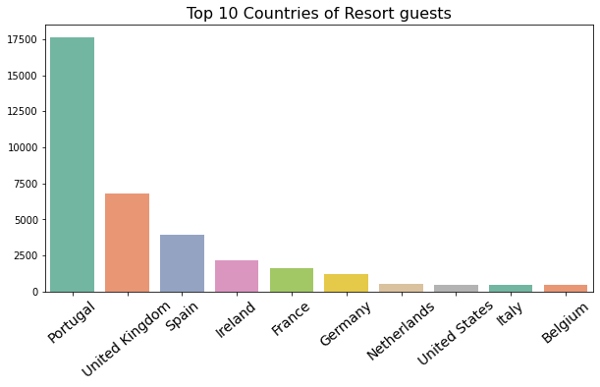
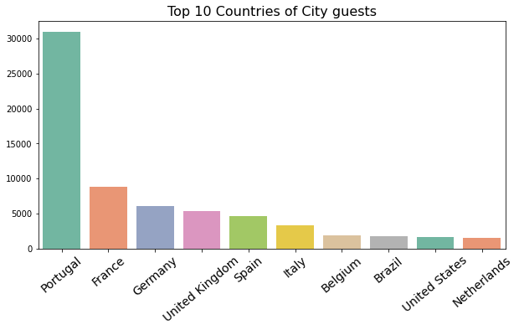
Countries of our guests
Countries of our guests
What are the top 10 countries of Resort hotels guests?
What are the top 10 countries of city hotels guests?

Slide 14
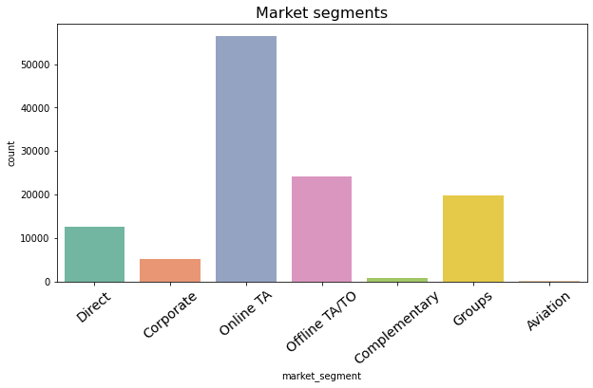
Countries of our guests
Market Segment
Which Market segment is repeated the most?
Which Market segment has the most cancellations?
Market Segment | Percentage
Online TA | 46.89%
Groups | 27.35%
Offline TA/TO | 18.79%
Direct | 4.37%
Corporate | 2.24%
Complementary | 0.21%
Aviation | 0.117%

Slide 15
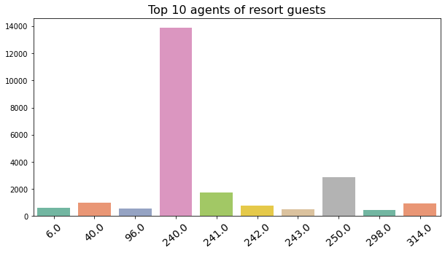
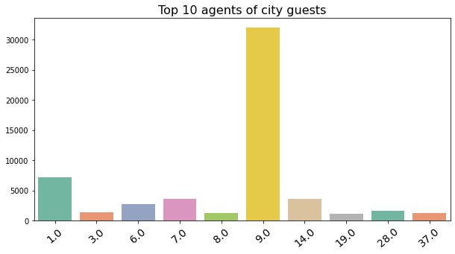
Countries of our guests
Agencies
What are the top 10 agencies that provide guests for resort hotels?
What are the top 10 agencies that provide guests for City hotels?

Slide 16
Countries of our guests
Customers
What is the count of each customer type?
What is the average number of car spaces requested?
Most of our clients don’t request car spaces
How many clients have requested at least one parking space?
About 6.21% of our clients have requested one parking space
Type | Percentage
Transient | 75.05%
Transient-Party | 21.04%
Contract | 3.41%
Group | 0.483%

Slide 17
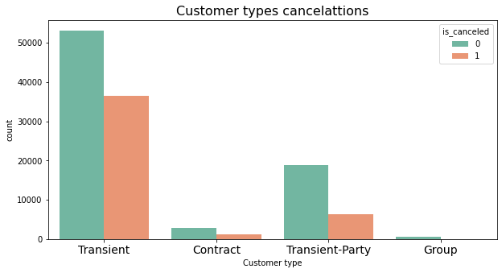
Countries of our guests
Customers cont.
Which customer type have made cancelations the most?
Customer type | Percentage
Transient | 82.56%
Transient-Party | 14.45%
Contract | 2.85%
Group | 0.133%

Slide 18
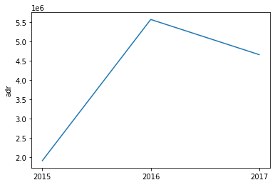
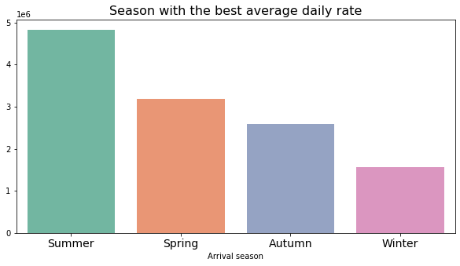
Countries of our guests
Average Daily Rate
Which season had the best total average daily rate?
Summer has the best adr of total 4825867.74 while winter has the worst adr of total 1560534.14
Changes of average daily rate over the years
As we can observe, total adr has dropped in year 2017 compared to year 2016

Slide 19
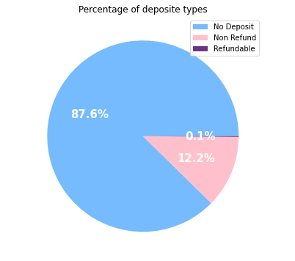
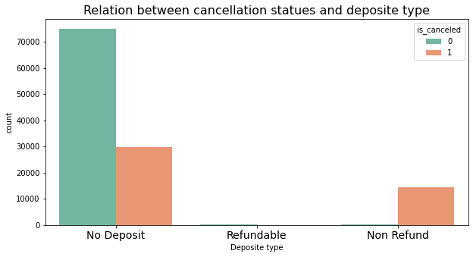
Countries of our guests
Deposit types
What is the percentage for each deposit type?
Does the deposit type have an affect on cancellations?
As we can observe, almost all guests who have paid a non refund deposit have cancelled their reservations

Slide 20

Summary

Slide 21
Countries of our guests
Summary
Problems
We should:
Almost all the guests who pay a non-refund deposit cancel their reservations.
Our total average daily rate has dropped down the past year.
Large number of reservations are being canceled.
Guests keep on making changes on their reservations.
Most of the reservations don’t include babies/children which means we should target families more.
More than 75% of the cancellations are from city hotels
Only 3% of our guests have repeated their visits to our hotel.
Improve our customer service.
Attract more family guests.
Convince our guests to take car spaces.
Attract different types of customers and market segments.

Slide 22

Thank you

